Slide 1
Games

Slide 2
Multiagent interactions
There’s no such thing as a single agent system.
Self-interested agents
Each agent has his own description of which states of the world he likes
Utility theory
An utility is a mapping from states of the world to real numbers
[Wooldridge 2009]
Does not necessarily mean that they want to cause harm to each other or they care only about themselves
[Wooldridge 2009] M. Wooldridge, An Introduction to Multiagent System (2nd edition), John Wiley & Sons, 2009.

Slide 3
田忌赛马
孫子見其馬足不甚相遠，馬有上、中、下輩。……孫子曰：“今以君之下駟與彼上駟，取君上駟與彼中駟，取君中駟與彼下駟。”既馳三輩畢，而田忌一不勝而再勝，卒得王千金。
《史記卷六十五·列傳第五·孫子吳起列傳》
 |  | 田忌
 |  | 上-中-下 | 上-下-中 | 中-上-下 | 中-下-上 | 下-上-中 | 下-中-上
齐威王 | 上-中-下 | ≤ +1000 | ≤ +1000 | ≤ +1000 | -1000 | +1000 | ≤ +1000

Slide 4
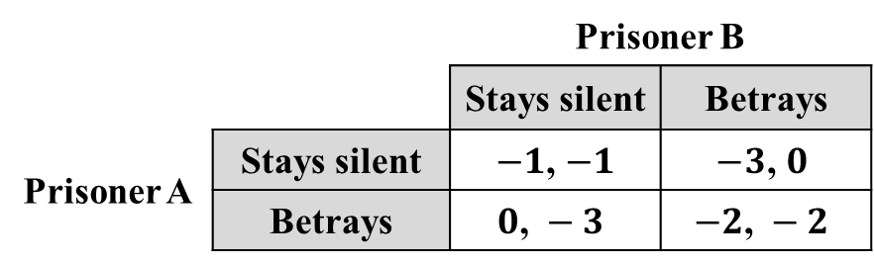
Games
So far we have assumed that the opponents’ strategy or the environment is static such that we can decide best response actions, but what if they are not?
Two thieves are arrested and imprisoned.
1. players (局中人)
2. actions / strategies (策略)
Game (博弈)
 |  | Prisoner B
 |  | Stays silent | Betrays
Prisoner A | Stays silent | $−1$, $−1$ | $$−3\text{, }0$$
 | Betrays | $$0\text{, }−3$$ | $$−2\text{, }−2$$
Prisoners’ dilemma (囚徒困境)
3. payoffs (受付)

Slide 5

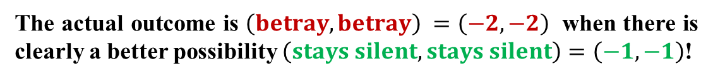
Prisoners’ dilemma (PD)
“separate interrogation”
 |  | Prisoner B
 |  | Stays silent | Betrays
Prisoner A | Stays silent | $−1$, $−1$ | $$−3\text{, }0$$
 | Betrays | $$0\text{, }−3$$ | $$−2\text{, }−2$$
What A thinks…
What B thinks…
1. If B stays silent, my best action is to betray.
1. ...
2. If B betrays, my best action is to betray.
2. ...
3. I will betray.
3. ...
The actual outcome is $\left(betray, betray\right) =\left(−2,−2\right)$ when there is clearly a better possibility $\left(stays silent, stays silent\right)=\left(−1,−1\right)$!
Well, shall we make a deal? (PD + communication)

Slide 6

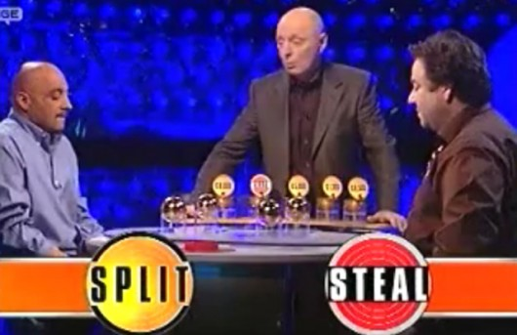
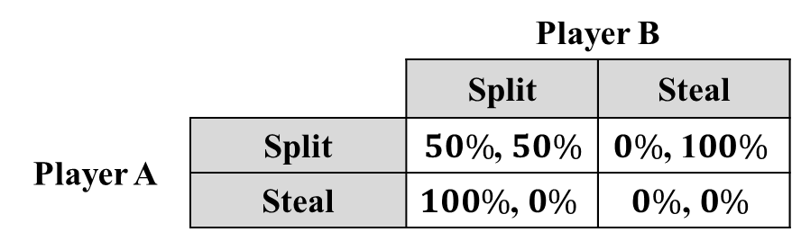
Golden balls
*
**
British game show
 |  | Player B
 |  | Split | Steal
Player A | Split | $50\%$, $50\%$ | $$0\%\text{, 1}00\%$$
 | Steal | $$100\%\text{, }0\%$$ | $$0\%\text{, }0\%$$
Within a sample of 574 players, 53% chose “split”.
[van den Assem et al. 2012]
Probability of “happy ending” $=\left(0.53\right)\left(0.53\right)≈0.28$
*Image from https://en.wikipedia.org/wiki/File:Golden_Balls.jpg, license: Non-free content, fair use.
**Image from http://www.doar.com/company-news/blog-post/in-praise-of-extreme-strategy/, Oct 25, 2015.
[van den Assem et al. 2012] M. J. van den Assem, D. van Dolder, and R. H. Thaler, Split or steal? Cooperative behavior when the stakes are large, Management Science, 58(1): 2-20, 2012.

Slide 7




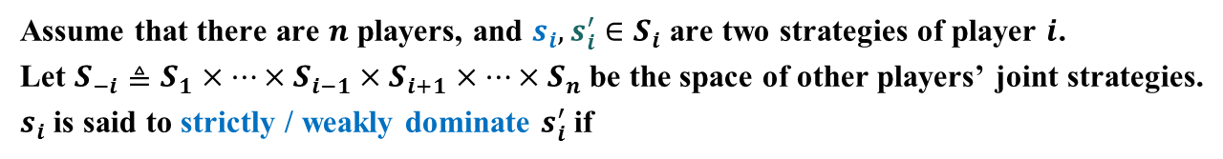
Self-interest vs. the common good
 |  | Prisoner B
 |  | Stays silent | Betrays
Prisoner A | Stays silent | $−1$, $−1$ | $$−3\text{, }0$$
 | Betrays | $$0\text{, }−3$$ | $$−2\text{, }−2$$
What do we mean by “optimal strategy”?
Considering a prisoner’s self-interest, the optimal strategy is indeed to betray.
“Betray” is a strictly dominant strategy (严格优超策略).
Assume that there are $n$ players, and $s_{i},s_{i}^{′}∈S_{i}$ are two strategies of player $i$.
Let $S_{−i}≜S_{1}×⋯×S_{i−1}×S_{i+1}×⋯×S_{n}$ be the space of other players’ joint strategies.
$s_{i}$ is said to strictly / weakly dominate $s_{i}^{′}$ if
$$∀s_{−i}∈S_{−i}$$
$$u_{i}\left(s_{i},s_{−i}\right)>u_{i}\left(s_{i}^{′},s_{−i}\right)$$
$$u_{i}\left(s_{i},s_{−i}\right)≥u_{i}\left(s_{i}^{′},s_{−i}\right)$$

Slide 8





Self-interest vs. the common good
 |  | Prisoner B
 |  | Stays silent | Betrays
Prisoner A | Stays silent | $−1$, $−1$ | $$−3\text{, }0$$
 | Betrays | $$0\text{, }−3$$ | $$−2\text{, }−2$$
What do we mean by “optimal strategy”?
Considering social welfare (i.e., total payoff), both staying silent is the optimal strategy, with a total payoff of $\left(−1 \right)+\left(−1 \right)=−2$.
Considering Pareto efficiency (a.k.a. Pareto optimality), all strategies except for both betraying is acceptable.
$s=\left(s_{1},s_{2},⋯,s_{n}\right)$ is Pareto optimal if there is no $s^{′}=\left(s_{1}^{′},s_{2}^{′},⋯,s_{n}^{′}\right)$ such that
$∀i$:
$$u_{i}\left(s^{′}\right)≥u_{i}\left(s\right)$$
and
$∃i$:
$$u_{i}\left(s^{′}\right)>u_{i}\left(s\right)$$
“skylines”

Slide 9
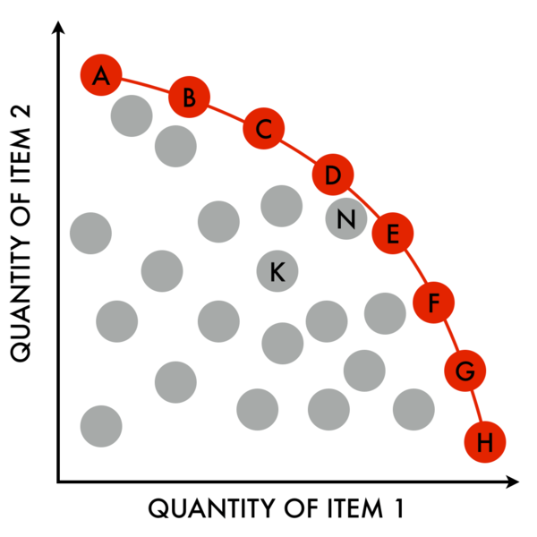
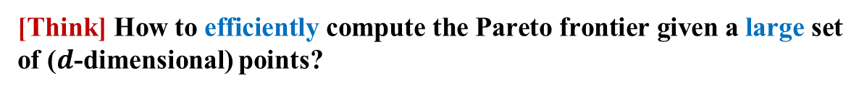
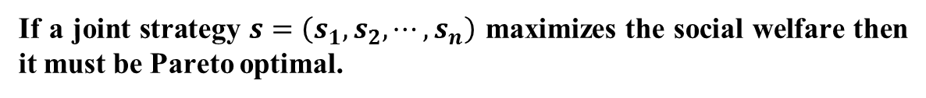
Pareto optimality
Pareto frontier
N Pareto dominates K
If a joint strategy $s=\left(s_{1},s_{2},⋯,s_{n}\right)$ maximizes the social welfare then it must be Pareto optimal.
Why?
[Think] How to efficiently compute the Pareto frontier given a large set of ($d$-dimensional) points?
[Papadias et al. 2003]
Image from https://commons.wikimedia.org/wiki/File:PareoEfficientFrontier1024x1024.png, license: CC-BY-SA-3.0.
[Papadias et al. 2003] D. Papadias, Y. Tao, G. Fu, and B. Seeger, An optimal and progressive algorithm for skyline queries, in: SIGMOD, 2003.

Slide 10
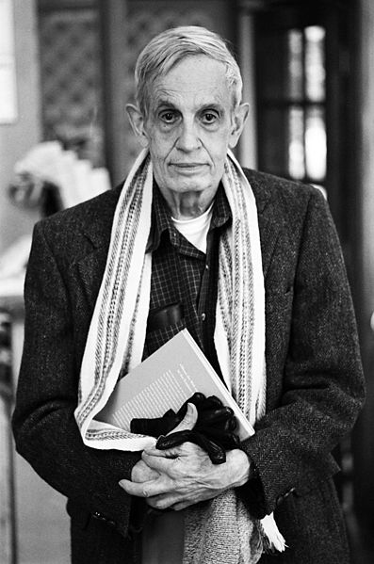

In memory of John F. Nash
John F. Nash (1928 – 2015 May 23)
economics
evolutionary biology
artificial intelligence
accounting
computer science
politics
military theory
*
game theory
differential geometry
partial differential equations
1994 Nobel Memorial Prize in Economic Sciences
2015 Abel Prize for his work on nonlinear PDEs
**
1959 – mid 1980s Paranoid schizophrenia (偏执型精神分裂症)
1998 A Beautiful Mind (book) by Sylvia Nasar
2001 A Beautiful Mind (film) directed by Ron Howard
* https://commons.wikimedia.org/wiki/File:John_Forbes_Nash,_Jr._by_Peter_Badge.jpg (CC-BY-SA-3.0), Oct 26, 2015.
** https://en.wikipedia.org/wiki/File:A_Beautiful_Mind_Poster.jpg (non-free, fair use), Oct 26, 2015.

Slide 11
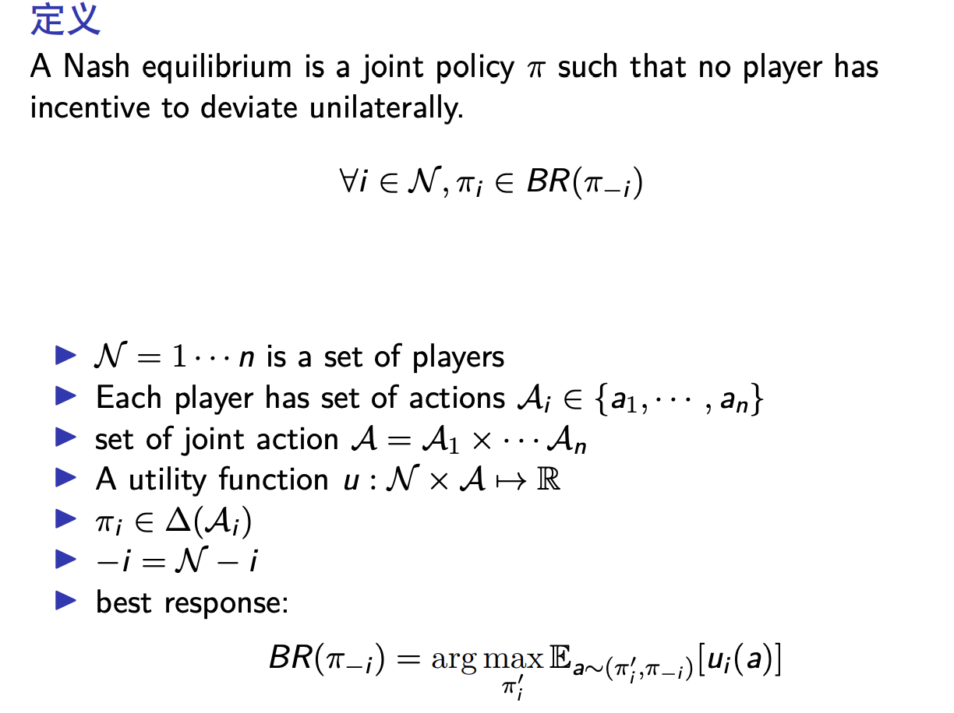
Nash equilibrium (NE)

Slide 12
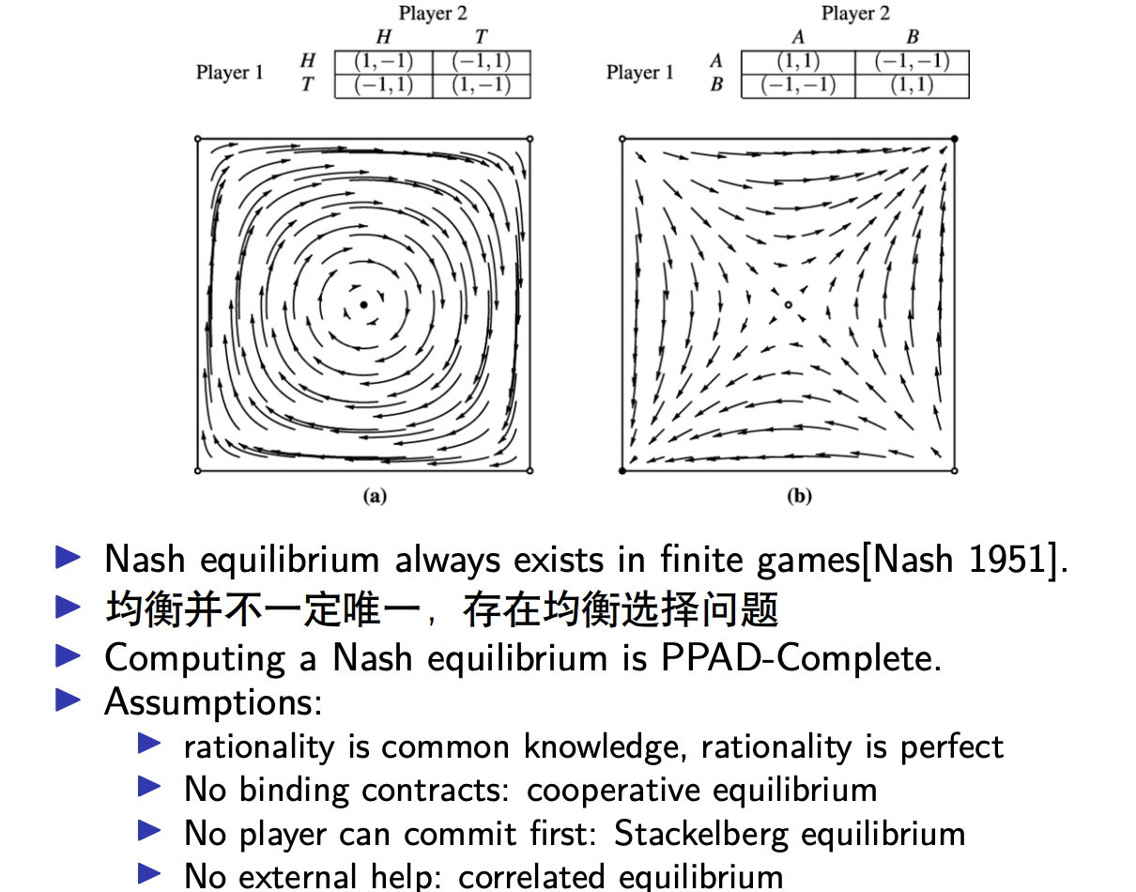
Nash equilibrium (NE)

Slide 13
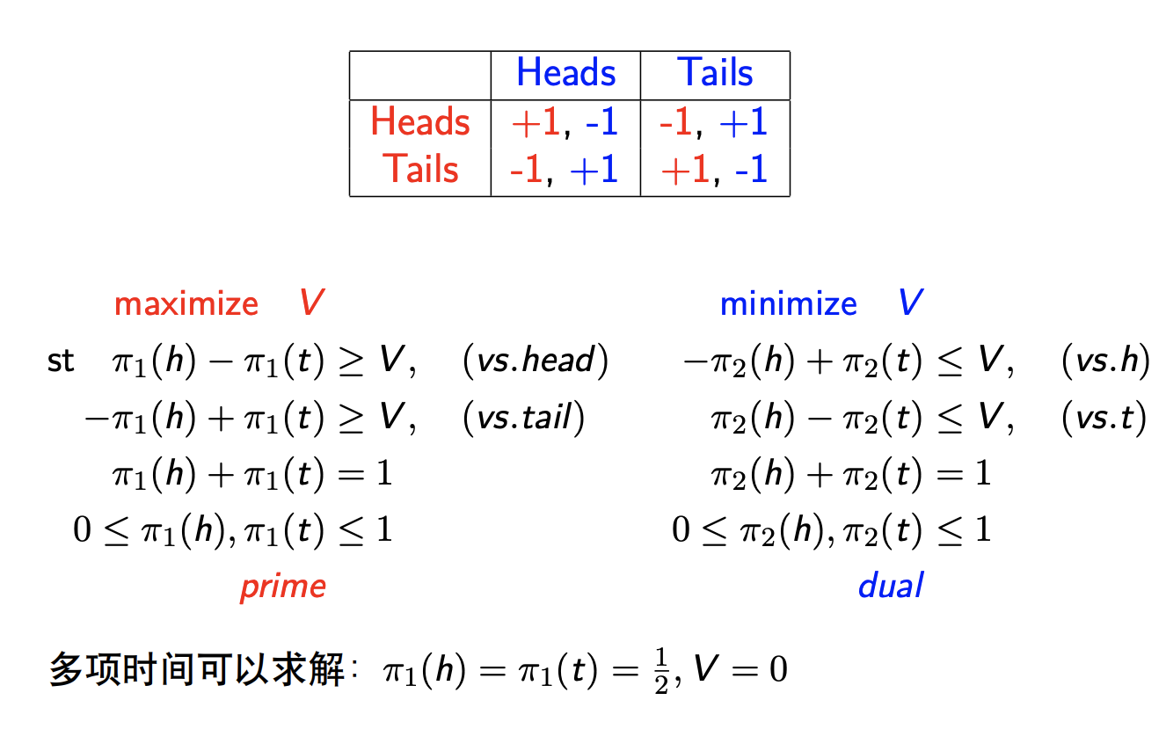
Computing Nash equilibria: linear prog.

Slide 14
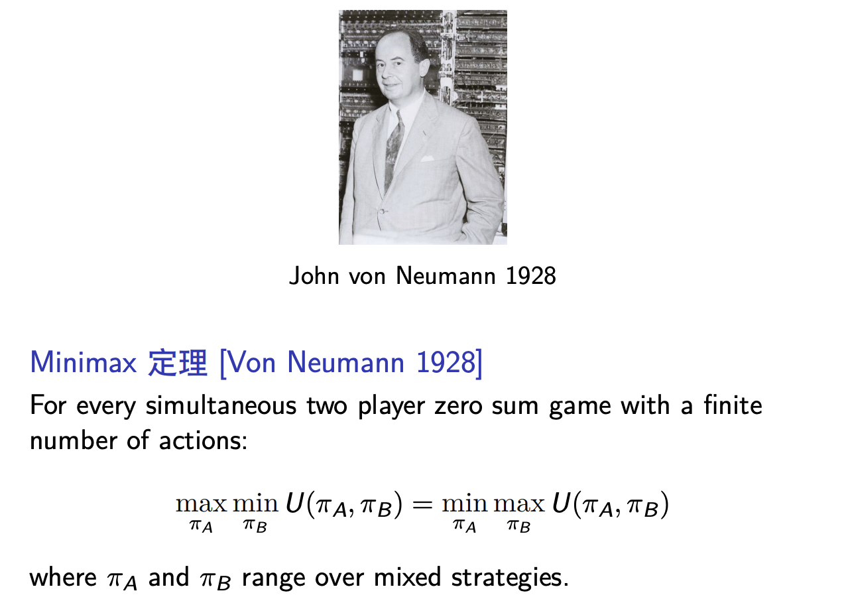
Minimax 定理

Slide 15
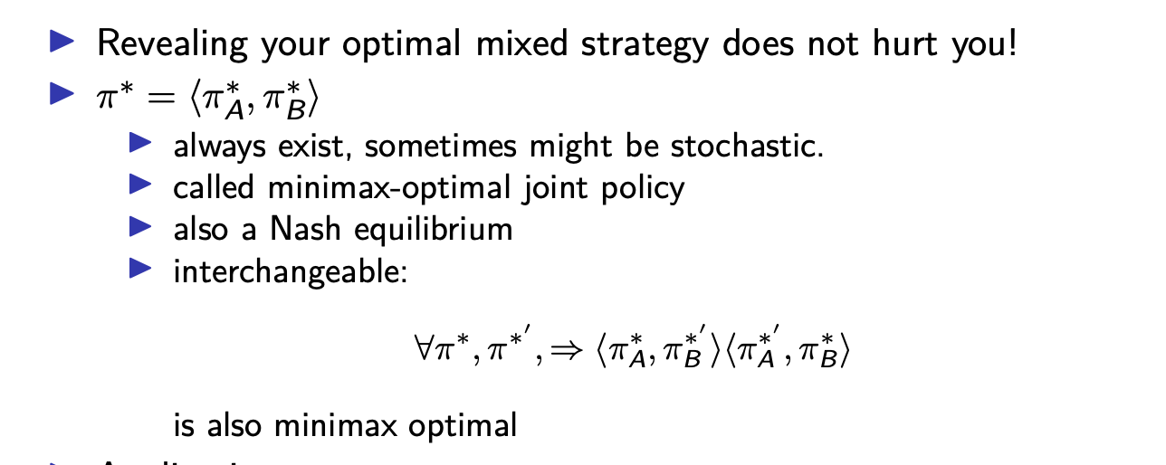
Minimax 定理

Slide 16


Nash equilibrium (NE)
$$∀i, ∀s_{i}∈S_{i}: u_{i}\left(s^{∗}\right)≥u_{i}\left(s_{i},s_{−i}^{∗}\right)$$
(weak Nash equilibrium)
$$∀i, ∀s_{i}∈S_{i}: u_{i}\left(s^{∗}\right)>u_{i}\left(s_{i},s_{−i}^{∗}\right)$$
(strict Nash equilibrium)
 |  | Prisoner B
 |  | Stays silent | Betrays
Prisoner A | Stays silent | $−1$, $−1$ | $$−3\text{, }0$$
 | Betrays | $$0\text{, }−3$$ | $$−2\text{, }−2$$
strict Nash equilibrium
 |  | Player B
 |  | Split | Steal
Player A | Split | $50\%$, $50\%$ | $$0\%\text{, 1}00\%$$
 | Steal | $$100\%\text{, }0\%$$ | $$0\%\text{, }0\%$$
weak Nash equilibria

Slide 17
Algorithms for one shot game
Fictitious Play [Brown 1951]
double oracle [HB McMahan 2003]
regret matching
follow the regularised leader
…

Slide 18
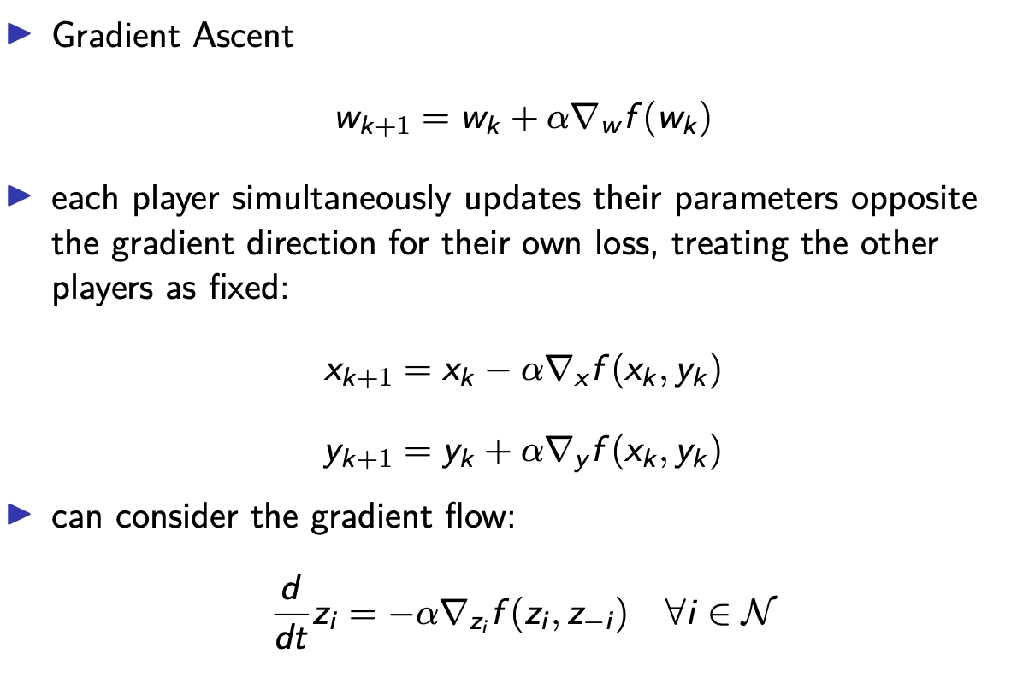
Gradient Descent-Ascent(GDA)

Slide 19
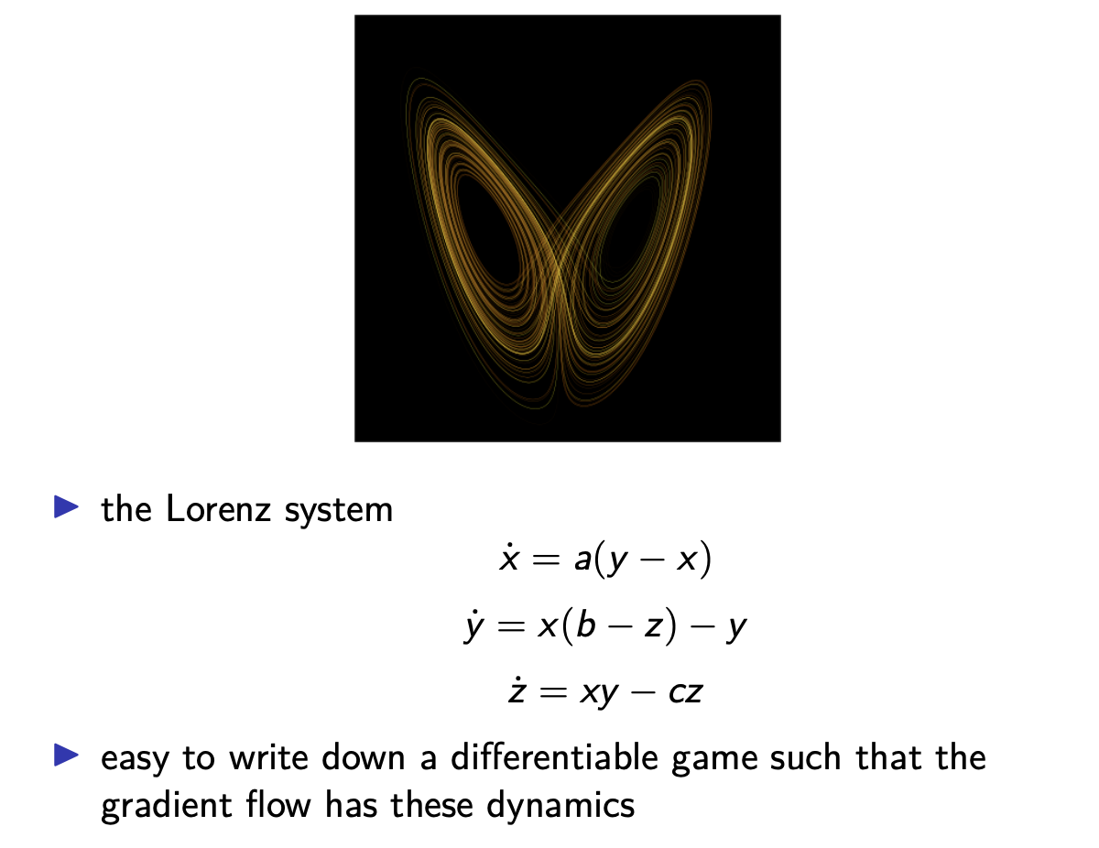
Lorenz system

Slide 20
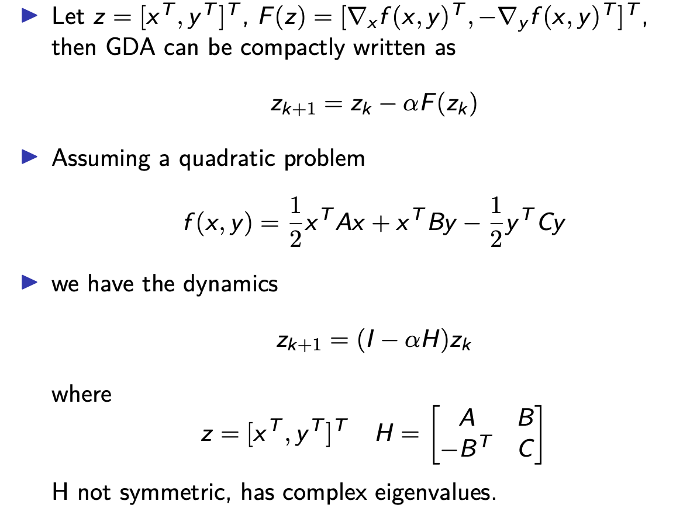
Gradient Descent-Ascent(GDA)

Slide 21
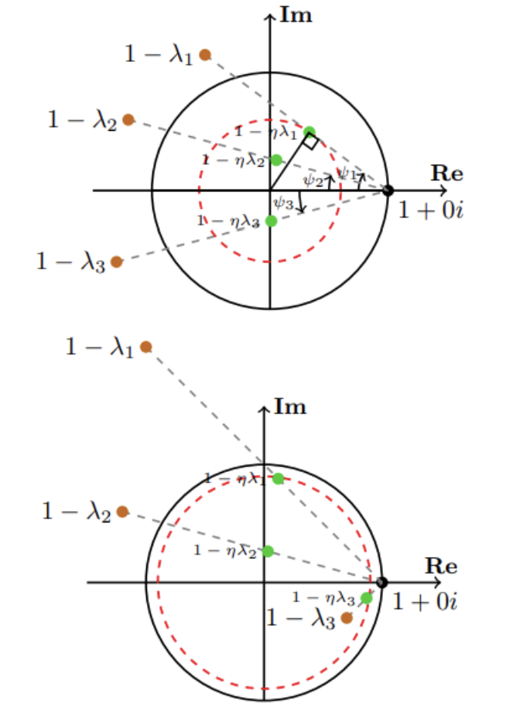
Convergence Analysis of GDA
Negative momentum(Gidel 2019)

Slide 22
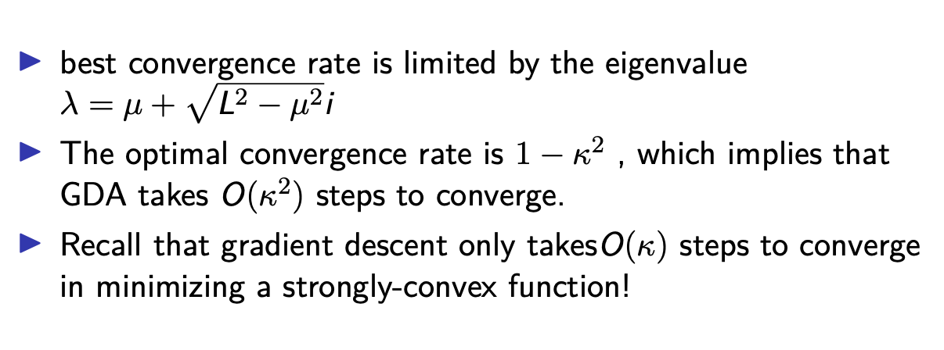
Convergence Analysis of GDA

Slide 23
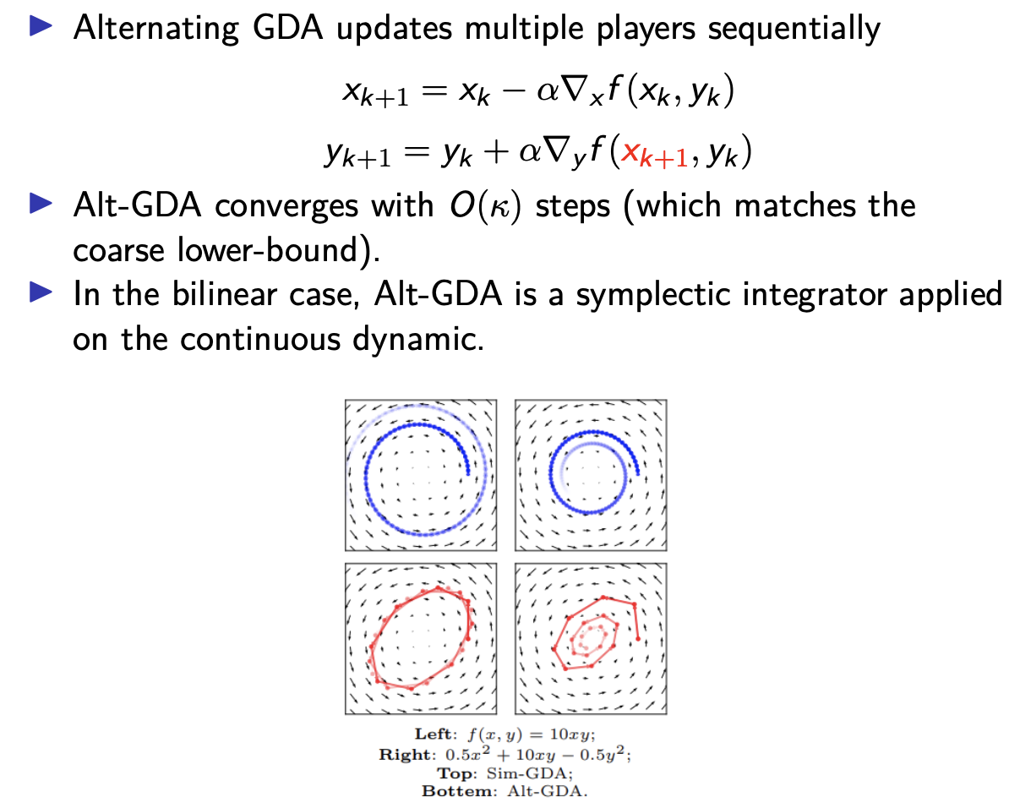
Alternating Gradient Descent-Ascent

Slide 24
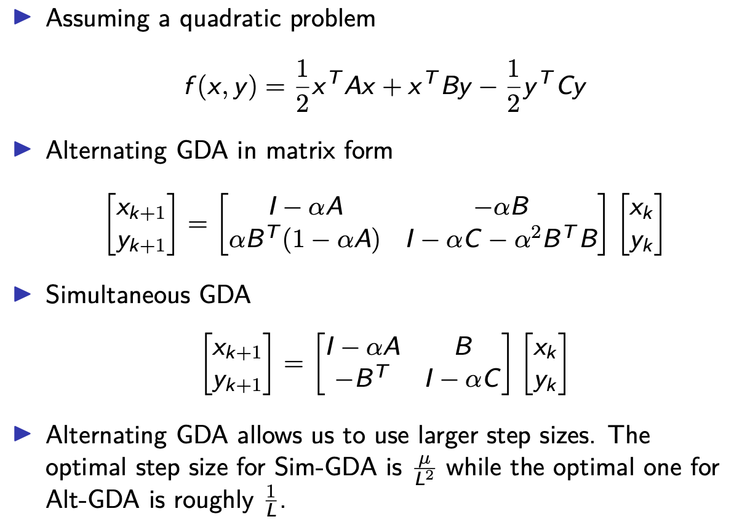
Alternating Gradient Descent-Ascent

Slide 25
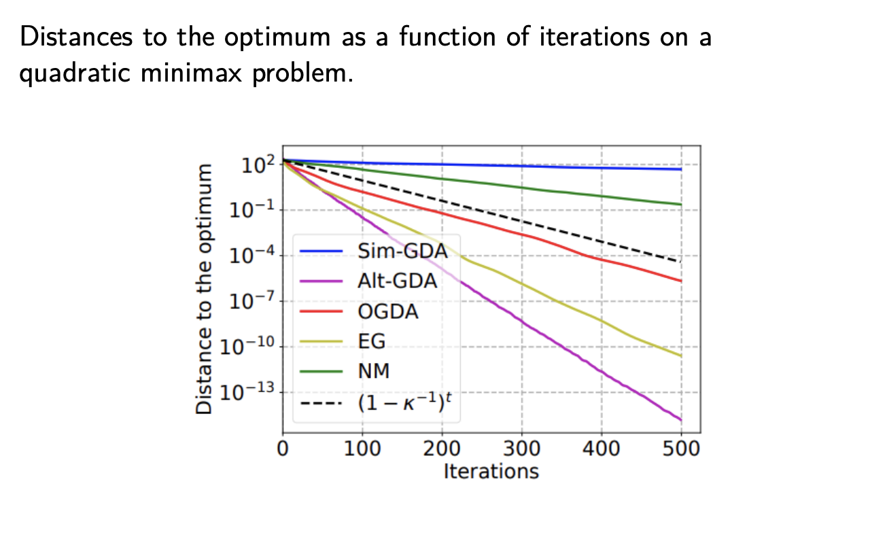
Comparison between different algorithms

Slide 26
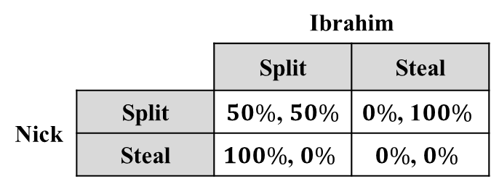
Back to Prisoners’ dilemma…
*
 |  | Ibrahim
 |  | Split | Steal
Nick | Split | $50\%$, $50\%$ | $$0\%\text{, 1}00\%$$
 | Steal | $$100\%\text{, }0\%$$ | $$0\%\text{, }0\%$$
“The weirdest split or steal ever”: Nick Corrigan vs. Ibrahim Hussein
Nick insisted that he would Steal regardless of what Ibrahim might do, but promised that he would give Ibrahim half of the money after he won.
Ibrahim’s best (rational) response becomes Split.
Nick chose Split in the end.
In fact, Ibrahim was going to choose Steal.
* Image from http://www.doar.com/company-news/blog-post/in-praise-of-extreme-strategy/, Oct 25, 2015.

Slide 27
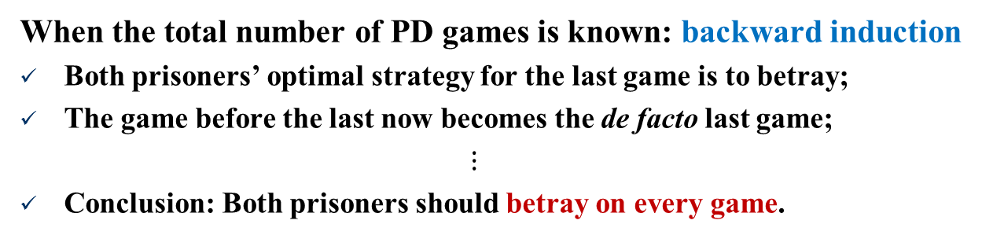

Back to Prisoners’ dilemma…
Iterated prisoners’ dilemma (IPD)
A prisoner will have chance to retaliate if her opponent betrays.
 |  | Prisoner B
 |  | Stays silent | Betrays
Prisoner A | Stays silent | $−1$, $−1$ | $$−3\text{, }0$$
 | Betrays | $$0\text{, }−3$$ | $$−2\text{, }−2$$
When the total number of PD games is known: backward induction
Both prisoners’ optimal strategy for the last game is to betray;
The game before the last now becomes the de facto last game;
$⋮$
Conclusion: Both prisoners should betray on every game.

Slide 28

Back to Prisoners’ dilemma…
Axelrod’s tournament on iterated prisoners’ dilemma (IPD)
Tit for tat with forgiveness
Stays silent in the 1st game
Does what her opponent did in the previous game
Sometimes (i.e., w/prob. 1%-5%) stays silent anyway
Characteristics of successful programs
Nice
Retaliating
Forgiving
Non-envious
 |  | Prisoner B
 |  | Stays silent | Betrays
Prisoner A | Stays silent | $−1$, $−1$ | $$−3\text{, }0$$
 | Betrays | $$0\text{, }−3$$ | $$−2\text{, }−2$$

Slide 29
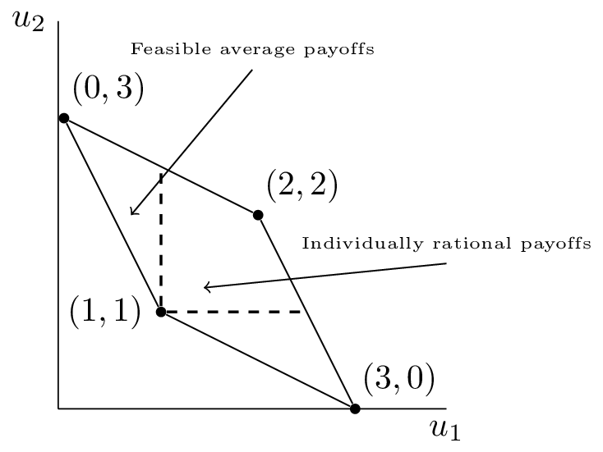
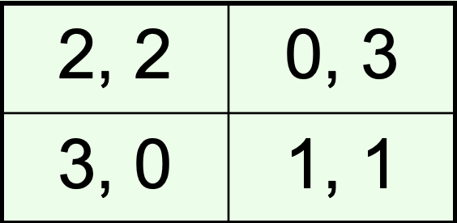
Folk Theorem [Aumann]
Can we somehow characterize the equilibria of infinitely repeated games?
We characterize what (averaged) utilities (u1 , u2 , …, un ) the agents can get in equilibrium
Folk theorem: a utility vector can be realized by some Nash equilibrium if and only if it is both feasible and enforceable
The utilities must be feasible: there must be outcomes of the game such that the agents, on average, get these utilities
In general, convex combinations of the outcomes of the game are feasible
They must also be enforceable: deviation should lead to punishment that outweighs the benefits of deviation
A utility for an agent is not enforceable if the agent can guarantee herself a higher utility

Slide 30
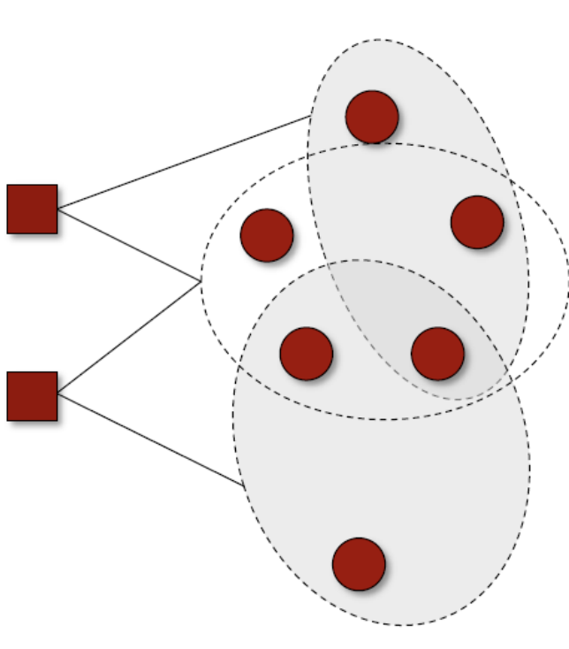
Security games
Security Games
Defender (leader) has 𝑘 identical patrol units
Defender wants to defend a set of 𝑛 targets 𝑇
In a pure strategy, each resource can protect a subset of targets 𝑆 ⊆ 𝑇 from a given collection 𝒮
A target is covered if it is protected by at least one resource
Attacker wants to select a target to attack
For each target, the defender and the attacker have two utilities: one if the target is covered, one if it is not.
Defender commits to a mixed strategy; attacker follows by choosing a target to attack.
Q: Can the leader lose in Stackelberg equilibrium compared to a Nash equilibrium?
A: No.

Slide 31

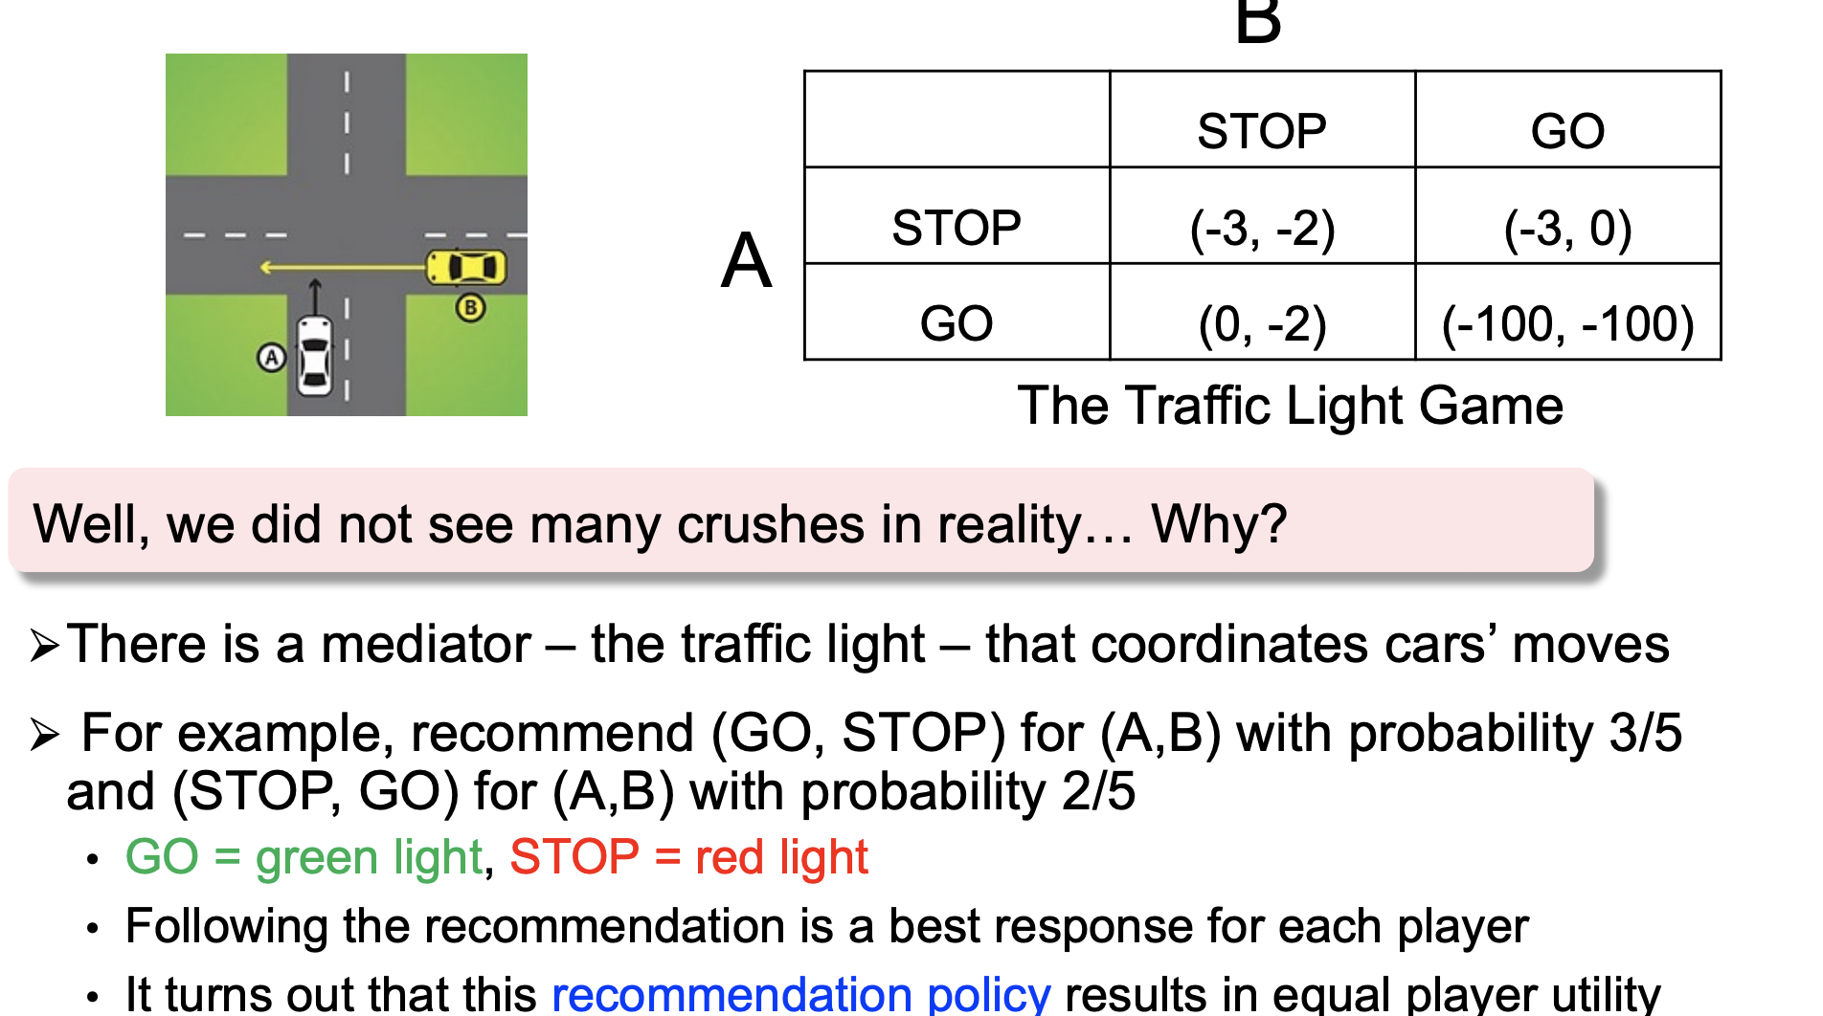
Correlated equilibrium

Slide 32
Summary
Multiagent interactions
Game theory
Representation of games (SNF, general form, GNF)
Rationality / optimality
Nash equilibria
Existence: hardness in deciding existence
Computation: hardness in computing NEs, algorithms, and tools
Iterative / repeating games
Backward induction
The power of “tit for tat”
Bayesian games

